Slide 1


SOP – Virtual CFO Pillar V – Data Analytics and Dashboard Date of Publication : 24/11/23

Slide 2
Standard Format of Dashboard
Key performance indicator
Financial summaries that the client wants to see
Budget v/s Actuals
Expenses analysis and Market analysis
Executive summary
Year to date summary
This is the initial framework, which can be modified by adding or removing metrics according to the intelligence that the client wants.

Slide 3
Inputs from the clients
Access to their ERP, or data warehouse
Metrics and KPIs they want to see
Their present performance management framework
Their aspirations and budgets
Historical data for the KPIs, including benchmarks and targets.
Regular updates of data needed for the dashboard (Update frequency)
Understanding the client’s industry and market segment
Preferences in visualization formats

Slide 4
Dashboard– Process Flow
Step 2: Data Gathering and Integration
2
3
Step 3: Design and Develop Dashboard
1
4
Step 1: Define Objectives and Requirements
Step 4: Testing and Validation
5
6
Step 5: Deployment and Access Control
Step 6: Maintenance and Improvements

Slide 5
Step 1: Define Objectives and Requirements
Identify key business goals and KPIs through stakeholder interviews and workshops.
Determine dashboard purpose (monitoring, analytics, operations etc) and end-user persona (executive, manager, analyst).
Define specific metrics and dimensions to track based on business needs.
Specify minimum viable functionality and features (filters, drill-downs, derived metrics etc).
Document technical specifications - data sources, update frequency, software platforms.
Create user stories to capture detailed requirements from multiple perspectives.
Obtain sign-off on requirements from all client stakeholders.

Slide 6
Step 2: Data Gathering and Integration
Catalogue all potential data sources (CRM, ERP, databases, APIs, spreadsheets etc).
Assess data quality - accuracy, completeness, consistency. Cleanse and transform as needed.
Model entity relationships to link datasets via common fields.
Build ETL processes to automate data integration from diverse sources.
Standardize date formats, naming conventions, schema etc across sources.
Validate integrated data, check for errors, duplicates, missing values.
Optimize data model - indexes, aggregation, compression - for fast query performance.
Store integrated data in a dedicated database or data warehouse.

Slide 7
Step 3: Design and Develop Dashboard
Evaluate different dashboarding platforms based on feature set, scalability, pricing, usability.
Create wireframes and mockups to capture initial design concepts.
Standardize layouts, color schemes, font usage per client brand guidelines.
Build charts, tables, KPI visualizations to present data insights effectively.
Implement custom interactive functionality via scripts, plugins, APIs.
Create dynamic filters, actions, parameters to customize view for each user.
Implement alerting, notifications based on defined trigger conditions.
Configure autosave, versioning, git integration for iterative development.
Perform extensive unit testing throughout development process.

Slide 8
Step 4: Testing and Validation
Verify calculation logic, data accuracy across all metrics and visuals.
Check for errors or unexpected behaviors in different use cases and with different parameter inputs.
Review dashboard security, access controls, and permissions functionality.
Load test dashboard with simulated production-level data volumes. Tuning as needed.
Solicit feedback from all stakeholder groups through demos and review sessions.
Address bugs, issues, change requests gathered during reviews and testing.
Iterate on information design, layouts, and styles based on feedback.
Gain official approval and sign-off for dashboard release from client sponsors.

Slide 9
Step 5: Deployment and Access Control
Provision and configure server infrastructure for dashboard application.
Implement robust security protocols including SSL, VPN, SSH, Role-based Access Control lists.
Create user roles and permission groups aligned to org structure.
Develop onboarding guides and usage instructions for end-users.
Automate dashboard data refreshes and job scheduling.
Set up monitoring for key performance metrics - uptime, load, errors.
Establish data recovery and backup procedures.
Roll out communication plan to introduce dashboard to end-users.

Slide 10
Step 6: Maintenance and Improvements
Monitor platform reliability and data accuracy - address any issues.
Develop a product roadmap based on new user requests and business needs.
Continually refine and optimize performance based on usage data and feedback.
Implement new features and enhancements in iterative development cycles.
Maintain comprehensive documentation and technical specifications.
Evaluate new dashboarding technology for possible upgrade.
Audit data sources regularly for changes that may impact dashboard.
Budget time and resources for ongoing dashboard operations and support.
Gather user feedback to guide improvement priorities.

Slide 11
Review and Refinement
The preliminary draft | MVP [Minimum Viable Product] will take a minimum of 14 days to create.
This MVP Will be send to the client engagement manager and Principal consultant for review first.
Then post review and it’s work this dashboard is presented to the client upon which we take his opinions and make changes if any
Then this dashboard is reviewed by CFO as well as the client post financial model preparation.
The finalized dashboard will be presented to the client in either as secure link, mobile BI or embedded analytics

Slide 12
Challenges
We encounter specific data integration difficulties that are distinct to the Client's ERP system and data accessibility
As of now, we lack Power BI Premium access
Our cloud architecture remains unresolved at this point
We might not have the internal capabilities to cater to multiple clients at the moment

Slide 13
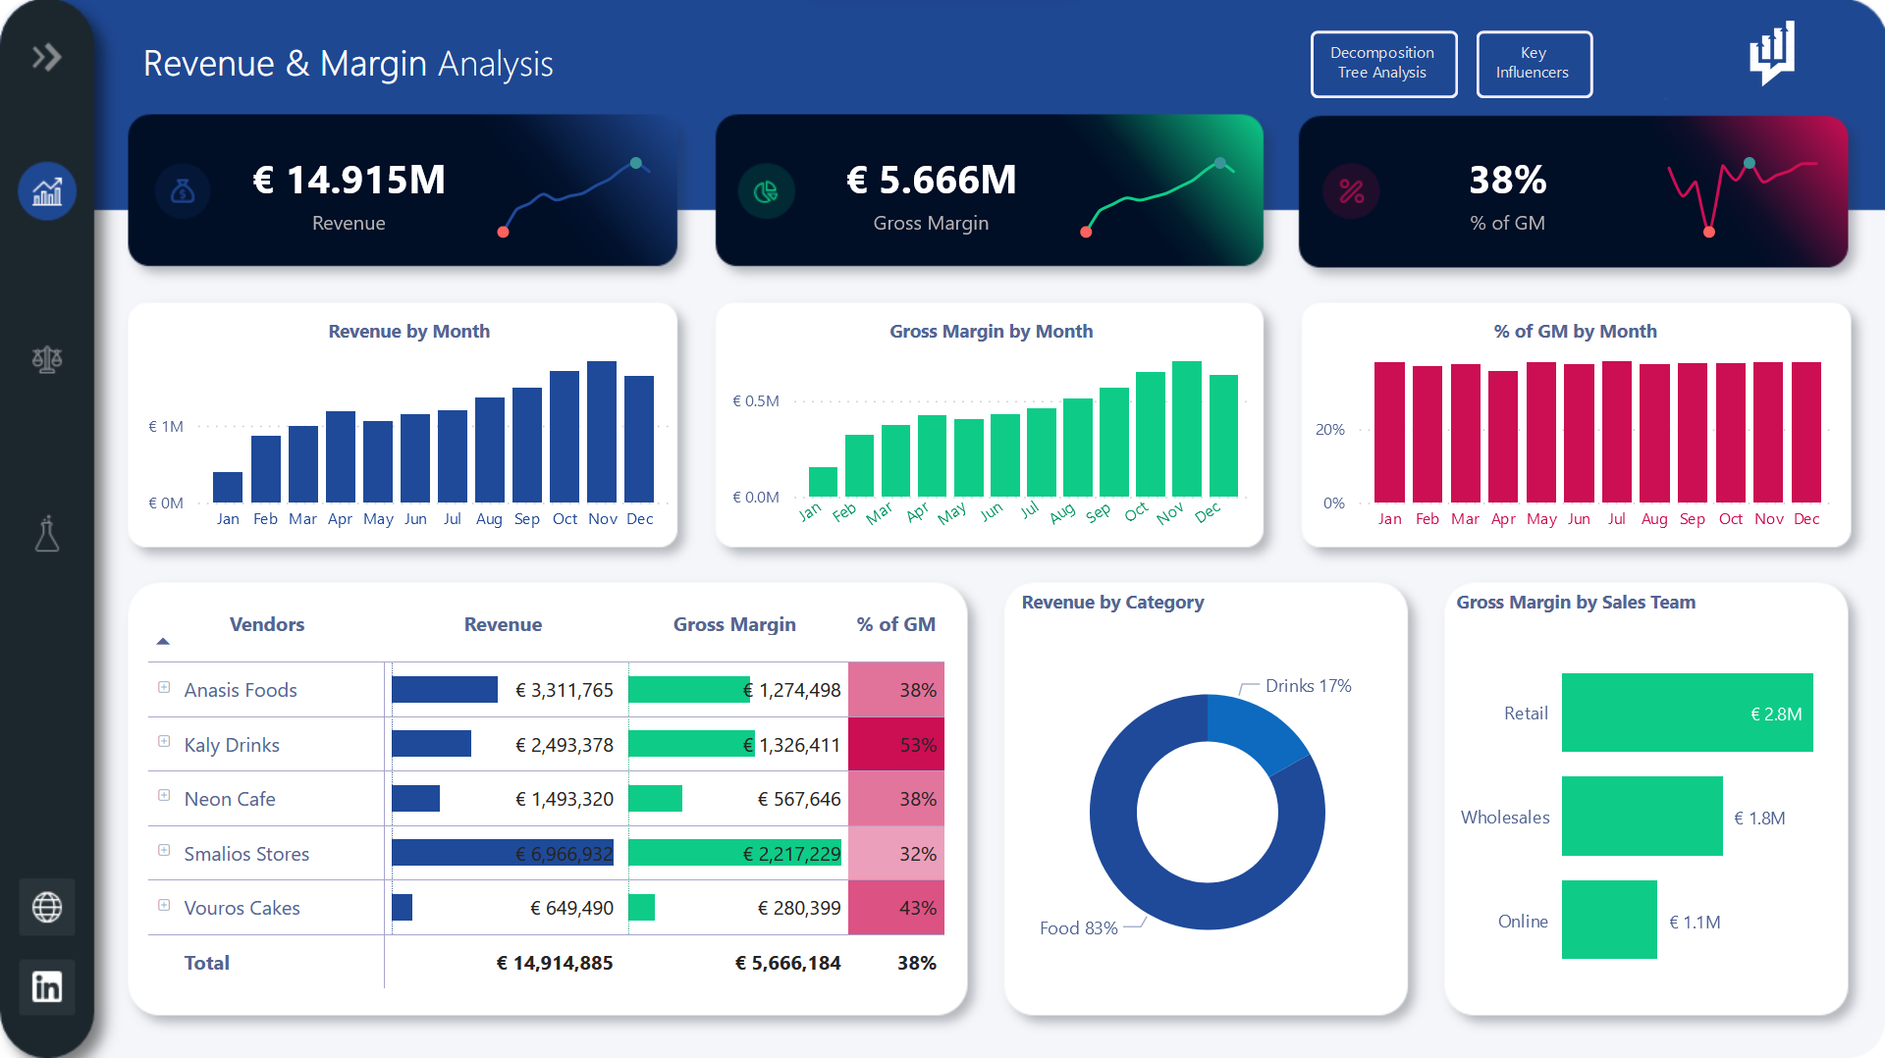
Revenue & Margin Analysis | Finance Dashboard

